Slide 1
OH MY WAR
OH MY GAMES present

Slide 2
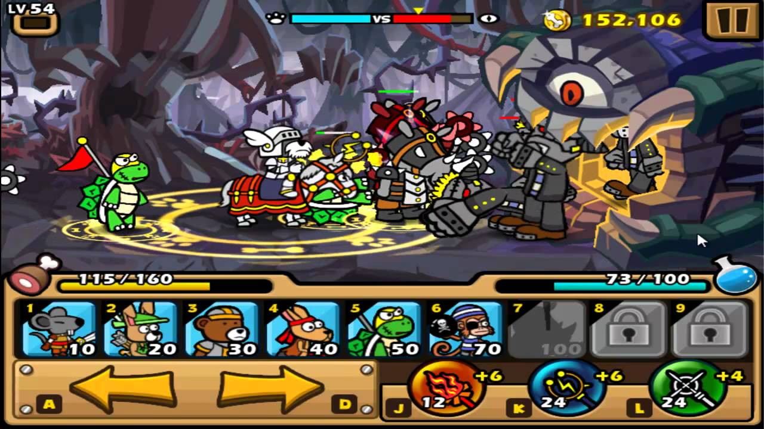
OH MY GAMES present

Slide 3
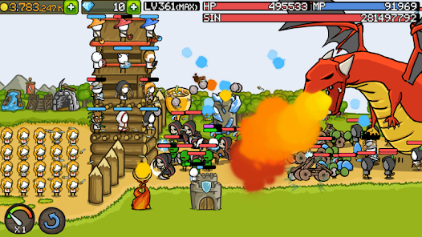
OH MY GAMES present

Slide 4
OH MY GAMES present

Slide 5

OH MY GAMES present

Slide 6

OH MY GAMES present

Slide 7


OH MY GAMES present

Slide 8
유저의 개입
OH MY GAMES present

Slide 9
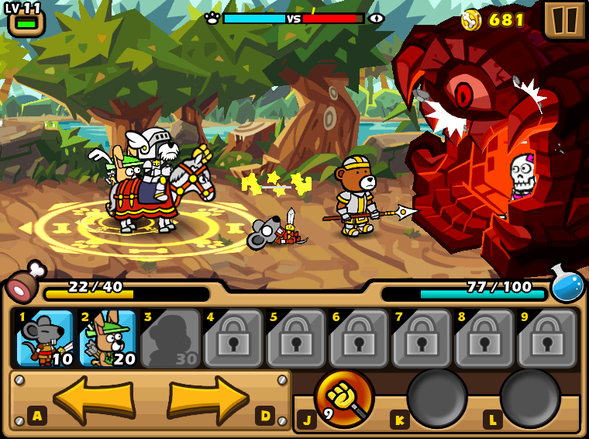
OH MY GAMES present

Slide 10

OH MY GAMES present

Slide 11

OH MY GAMES present

Slide 12
전략적 요소
OH MY GAMES present

Slide 13

OH MY GAMES present

Slide 14
OH MY GAMES present

Slide 15
OH MY GAMES present

Slide 16
OH MY GAMES present

Slide 17
OH MY GAMES present

Slide 18
OH MY GAMES present

Slide 19
OH MY GAMES present

Slide 20
보병 궁수 마법사 기사 도적 신관
OH MY GAMES present

Slide 21
이능술사
- 범위 내 유닛과 함께 다른 라인으로 텔포
- 상대 얼리기
패시브 - 주변 아군 이속 증가
기사
- 아군 추가체력 (보호막 개념)
- 검기 날리기
패시브 - 주변 아군 공격력 증가
OH MY GAMES present
OH MY WAR

Slide 22
OH MY WAR
OH MY GAMES present

